Slide 1
Biotin deficiency
Biotin is a cofactor in carboxylation and decarboxylation reactions involved in the metabolism of lipids, glucose, and some amino acids.

Slide 2
Functions:
Biotin is important for normal functions of :
1-Thyroid gland.
2-Adrenal gland.
3-Reproductive tract.
4-Nervous system.

Slide 3
Clinical signs:
1-In chicks and poults, a deficiency causes slow growth, ruffled feathers.
2-Bone deformities (perosis): In young.
3-Ataxia ( Incoordination) :Young and adult.
4- Skeletal deformities (e.g., bowed legs):Young.
5- Dermatitis: Extensive foot encrustation( Scabs) : Young and adult.

Slide 4
6- Chondrodystrophy (Abnormal cartilage
development): Young and adult.
7-Embryonic mortality.
8-Twisted, malformed beak ("parrot beak")
and reduced size (in young).
9- Poor egg production and hatchability(in
adults).

Slide 7
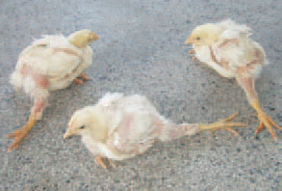
Chondrodystrophy

Slide 8
Post-mortem lesions:
1-Dryness and flakiness of the feet.
2-Toes may become necrotic and slough off.
3-Dermatitis may also appear on the eyelids, eyelids swell and stick together.

Slide 12
Diagnosis:
1-Signs.
2-Lesions.
Differential diagnosis:
Pantothenic acid deficiency (skin lesions).

Slide 13
Treatment:
Addition of biotin in feed or water.
Preventions:
Supplementation of diets with biotin.

